Slide 1
An Analysis of Hunting License Sales and Conservation
Maddox Johnston

Slide 2
Introduction
How does increasing hunting license prices affect license sales?
Why this study is necessary (Decline)
Hypothesis/Goals
Outline of Presentation: (Overview, Methods, Findings, Conclusion)

Slide 3
Overview of Topic: History of Hunting Licenses
What is a hunting license?
Evolution of purpose
1719 oysters, 1745 Cornhills
Nonresident (NJ)1873
Resident (MI) not until 1895

Slide 4
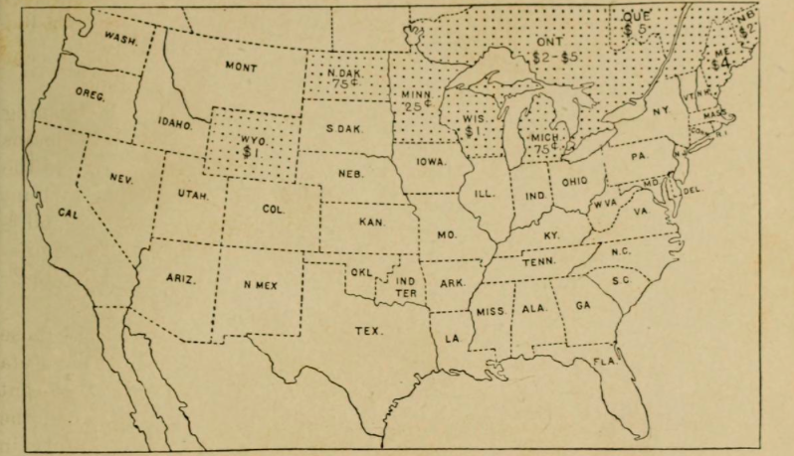
Overview of Topic: History of Hunting Licenses
States having resident license laws in 1900
Source: Palmer (1904)

Slide 5
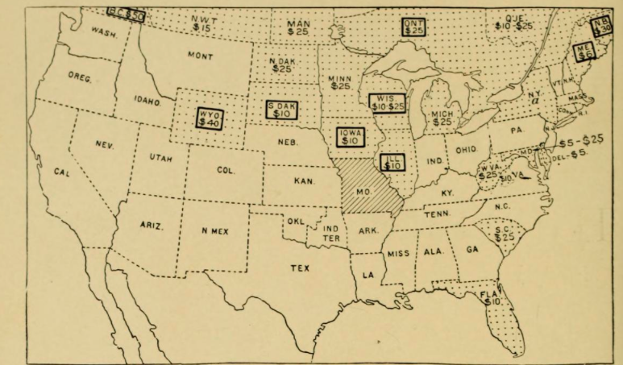
Overview of Topic: History of Hunting Licenses
States having nonresident license laws in 1900
Source: Palmer (1904)

Slide 6
Overview of Topic: Why Hunting is Declining
Loss of hunting land (expansions)
Less leisure time
Fewer youth hunters
Likely to continue (urbanization, generations)

Slide 7
Overview of Topic: Hunter Recruitment and Retention
Recruitment (licenses, education)
Retention (interest indicators)
Women high recruitment, low retention
Need mentorship, appeal & vigor

Slide 8
Overview of Topic: Hunter Recruitment and Retention
Regional changes in hunter numbers between 2001 and 2006
Source: USFW (2007).

Slide 9
Overview of Topic: Elasticity of Hunting Licenses
“the relationship between price and quantity demanded and provides a precise calculation of the effect of a change in price on quantity demanded” (Economics, 2015)
Goods are typically elastic
Hunting licenses different
Legislation impairs price changes

Slide 10
Methods
Statistical analysis of sales in 2014
Gathered resident and nonresident data
Performed analyses on separate criteria
Identified trends
Log Transformed

Slide 11
Findings: Resident Licenses

Slide 12
Findings: Resident Licenses
Price change effect on sales, revenue
-0.0878 (weak inelastic, 9%)
Significant: Total population & nonresident sales
0.4014 (40%, intuitive)

Slide 13
Findings: Resident Licenses
Elasticity of Various Criteria Relating to the Demand of Resident Hunting Licenses
Criteria | Elasticity Coefficient | Statistical Significance
Resident Hunting License Price | -0.0878 | No
Household Median Income | 0.6361 | No
Total State Population | 0.4014 | Yes
Non-Resident Hunting Licenses Sold | 1.0565 | Yes
Non-Resident Hunting License Price | -0.0169 | No
Ages 25-34 With at Least an Associate’s Degree | -0.3584 | No
Total Area of State | 0.0709 | No
State Population Who Live in Urban Areas | 0.3992 | No

Slide 14
Findings: Nonresident Licenses

Slide 15
Findings: Nonresident Licenses
.1018 (weak inelastic, positive, 10%)
Resident licenses significant
Others not significant, fit with theory
Ages 25-34 with associate’s degree: negative

Slide 16
Findings: Nonresident Licenses
Elasticity of Various Criteria Relating to the Demand of Nonresident Hunting Licenses

Slide 17
Discussion and Conclusion
Relatively inelastic economic goods
Resident- dissuasion, evasion, knowledgeable
Nonresident- positive (hunting states), policymakers
Revenue shortage, less conservation funds, hunters’ best interest to remedy
Small price increase
Goes toward conservation, benefitting recruitment retention and perpetuation (cycle)

Slide 18
Questions?

Slide 19
References
Baumeister, T., Cunningham, J., Gude, J., & Herbert, J. (2012, April). Deer and Elk hunter recruitment, retention, and participation trends in Montana. The Journal of Wildlife Management, 76(3), 471-479. doi:10.1371/journal.pone.0030142
Brown, T., Decker, D., & Enck, J. (2000, Winter). Status of hunter recruitment and retention in the United States. Wildlife Society Bulletin, 28(4), 817-824. http://dx.doi.org/10.1675/063.034.0103
Brown, T., & Connelly, N. (2004, Summer). Demand for big game and small game hunting licenses. Wildlife Society Bulletin, 42(2), 172-178. doi:10.1371/journal.pone.0072629
Commissioner’s Council on Hunting and Angling Recruitment and Retention. (2013). Recruiting and retaining hunters and anglers. Minnesota Department of Natural Resources.
Derichs, L. (2014, March 3). Hunting license sales. Retrieved from http://www.ducks.org/conservation/waterfowl-biology/hunting-licenses
Economics Online. (2015). Price elasticity of demand. Retrieved from http://www.economicsonline.org.uk
Emmett, O. (2011, April 15). Conservation and license revenue. Retrieved from http://www.wyd.gov /rev/story.asp?id=17
Grant, R. (1991). The royal forests of England. Gloucestershire: Alan Sutton.
Hobson, S. (2005, December 21). An analysis of the sale of hunting licenses over 10 years. PLoS ONE, 5(3). doi:10.1585/journal.pone.0084394.34
Hurteau, D., & Love, C. (2008, November 18). Industry experts on why hunting is in a decline. Field and Stream.
Miller, J.r., & Hay, M.J. (1981). Determinants of hunter participation: duck hunting in the Mississippi flyway. Agricultural Economics, 63, 679-683.
Palmer, T. S. (1904). Hunting licenses: Their history, objects, and limitations. Washington: U.S. Dept. of Agriculture, Division of Biological Survey.
Poudyal, N., Cho, S., & Bowker, J. (2008). Demand for resident hunting in the southeastern United States. Human Dimensions of Wildlife, 13, 158-174. doi:10.1080/10871200801922965
Regehr, M. (2011, March). Hunting licenses and conservation in the Atlantic Flyway. Waterbirds, 34(1), 19-31. http://dx.doi.org/10.1675/063.034.0103
Ryan, E., & Shaw, B. (2011, October 4). Improving hunter recruitment and retention. Human Dimensions of Wildlife, 16(5), 311-317. http://dx.doi.org/10.1080/10871209.2011.559530
South Carolina DNR. (2007, October 24). South Carolina DNR License sales decline. Retrieved from http://www.dnr.sc.gov/
United States Bureau of the Census. (2015). Population estimates program. Retrieved from http://www.census.gov
United States Fish and Wildlife Service. (2007). 2006 national survey of fishing, hunting, and wildlife-associated recreation. Retrieved from http://www.usfw.gov
Wentz, J.R. (1996). Systematic strategies for recruiting, training, and retaining hunters and anglers. Transactions of the North American Wildlife and Natural Resources Conference, 61, 388-394.

